Slide 1
CAPSTONE PROJECT · FINAL PRESENTATION
Customer Loyalty
Predictive Analytics
Segmentation · Churn Prediction · Lifetime Value
Julian Cerro · Waleed El-Jack · Marianne Murrle · Rachel Schultz · Tiana Quiroga
Spring 2026

Slide 2
AGENDA
What We'll Cover Today
01
Problem Statement & Dataset
05
Churn Model Methodology
Business challenge, dataset selection, market context
Pipeline, preprocessing, LR vs. Random Forest
02
Exploratory Data Analysis
06
Churn Results
Demographics, spending patterns, channel behavior
Model performance, churn rates by segment
03
Segmentation Methodology
07
CLV Methodology & Results
K-Means setup, feature engineering, cluster validation
Formula, feature importance, predicted CLV by segment
04
Cluster Profiles & Insights
08
Recommendations
4 segments, revenue share, campaign response
Actionable strategies per segment

Slide 3
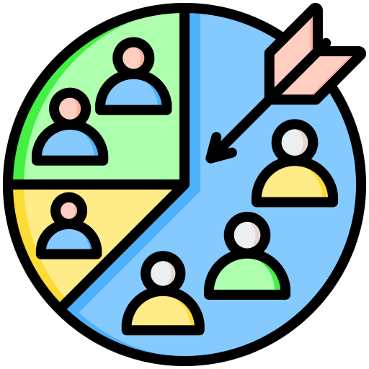

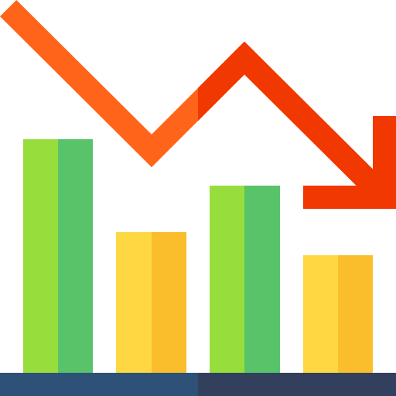
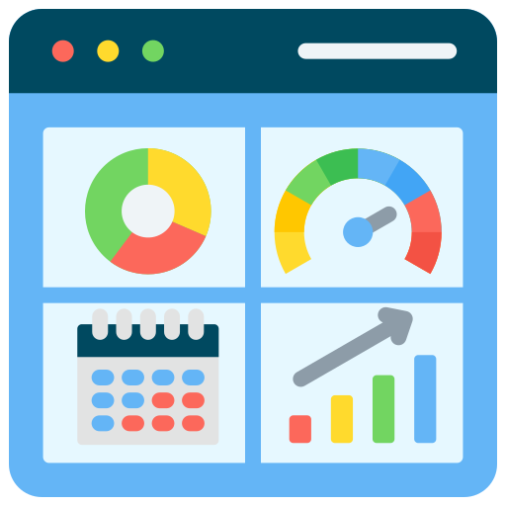
Four analytical objectives designed to turn customer data into actionable loyalty strategy
The Business Challenge
The retailer lacks a clear predictive strategy to strengthen customer loyalty, prevent churn, and maximize customer lifetime value, limiting sustainable growth.
Segment Customers
Predict CLV
Identify Churn Risk
Executive Dashboard
Group by Spend, Frequency, and Recency
Identify high- and low-value loyalty program members
Enable proactive retention for at-risk customers
Deliver insights for strategic decision-making

Slide 4
Synthetic dataset Kaggle retail dataset (2021) by Dr. Omar Romero-Hernandez. With rich behavioral and transactional features — similar structure to real-world retail loyalty programs
Dataset Selection
✗ Purchasing Behaviours
✗ Churn Prediction Dataset
✓ Customer Personality Analysis
Insufficient transaction history
Too few observations per customer
Short data window limits prediction
No loyalty/engagement variables
CLV cannot be truly modeled
Churn binary & retrospective only
2,240 customers · 29 features
Categories: Wines, Meat, Fish, Fruits, Sweets, Gold
Channels: Store, Web, Catalog, Deals
5 marketing campaigns tracked
Similar structure to real-world retail stores (Kroger, Whole Foods, Target, etc.)
Enables segmentation, CLV & churn
Data Cleaning & Feature Engineering
Missing Values
Outlier Removal
Standardization
Dropped Columns
New Features
Replaced 24 missing Income values with median
Flagged income >$500K; 3 customers age 100+ flagged
Education: relabeled to HS / Bachelors / Masters / PhD
Removed constant cols: Z_CostContact, Z_Revenue
Total_spent, Frequency, Age, Tenure, Web Conv. Rate, Total Children
Notes:
Closest to Santa Fe, New Mexico income, age and education levels

Slide 5
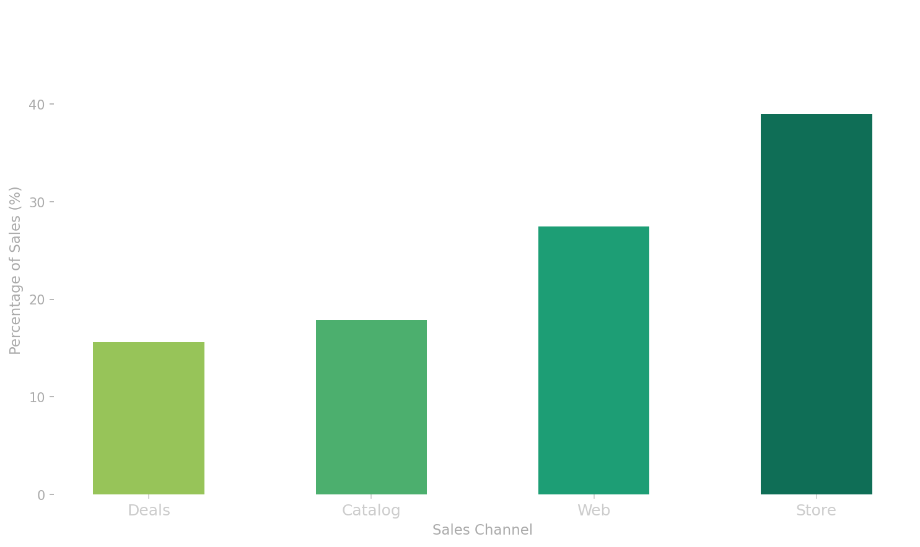
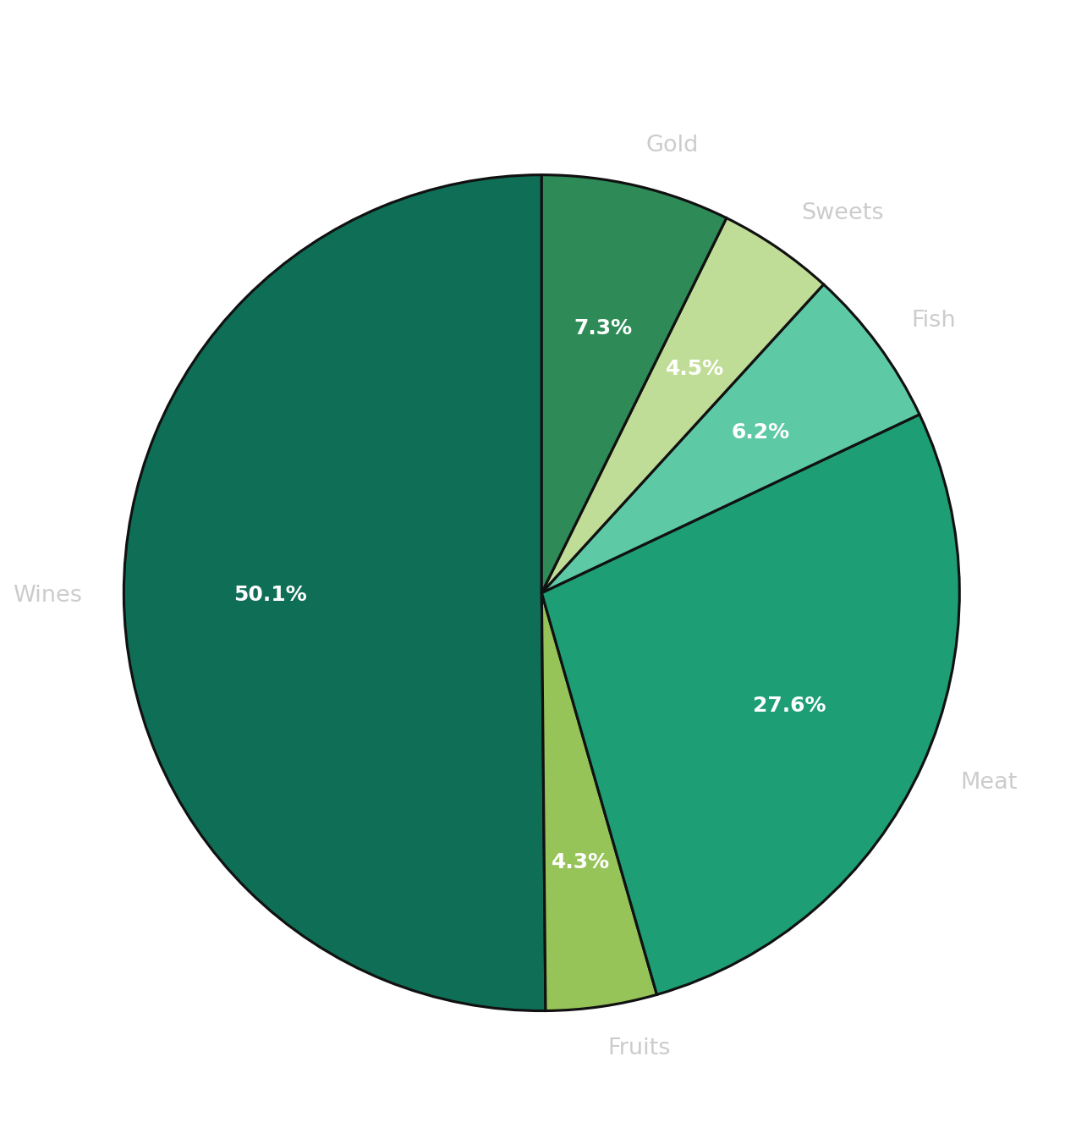
Understanding who our customers are before building any model
Customer Demographics & Spending Overview
56
$51,382
38.6%
71.5%
$33.33
$396
Median Age
Median Income
Married
Have Children
Avg Basket Size
Median Spend

Slide 6
Customer Segmentation
Summary
Group customers into 4 distinct segments based on Recency, Frequency, and Total Spend (RFM), identifying who is most valuable, most active, and most at risk.
Target each group with the right strategy, instead of a one-size-fits-all approach.
K-Means is a clustering algorithm that groups customers into segments based on similar behavior.
Segments:
High-Value: High Frequency | High Spend | Low Recency
Regular: High Frequency | High Spend | High Recency
Occasional: Low Frequency | Low Spend | Low Recency
At Risk: Low Frequency | Low Spend | High Recency
Segment Customers

Slide 7
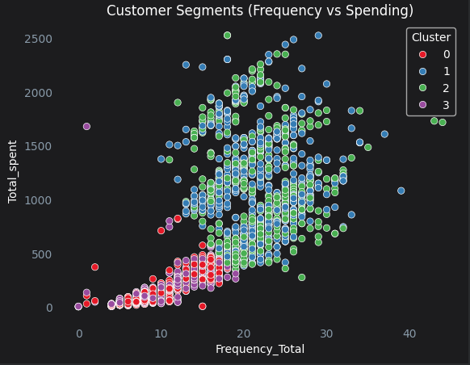
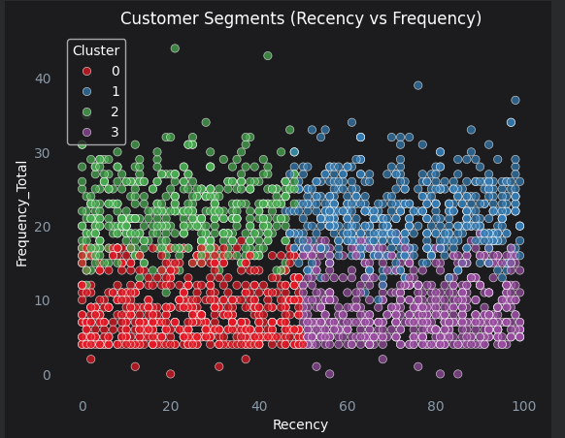
Grouping customers by behavior to enable targeted loyalty strategies
K-Means Clustering: Approach & Validation
Customer Segment Distribution by RFM Behavior
Key Insights:
High Value - Regular - Occasional - At Risk
The four clusters are relatively evenly distributed across the customer base.
Regular and At-Risk customers show higher churn risk, mainly driven by recency.
Regular and High-Value customers show the strongest spend and purchase frequency.
Feature Selection: Recency, Frequency,
Total Spend (RFM)
K-Means Clustering into 4 Segments
It is a simple and widely used retail framework to understand customer value and behavior.
RFM are strong indicators of customer engagement, loyalty, and profitability.
It created meaningful, actionable, and business-relevant customer segments.
In retail, segmentation is most useful when groups are clear and actionable, rather than overly complex.
Higher K values created groups that were too similar to each other

Slide 8
Four distinct customer segments — each with a clear profile, behavior pattern, and loyalty strategy
K-Means Clustering — 4 Customer Segments
High Value
Regular
Occasional
At Risk
Cluster Size
497 (22%)
Cluster Size
558 (25%)
Cluster Size
605 (27%)
Cluster Size
580 (26%)
Avg Spend
$1,114
Avg Spend
$1,158
Avg Spend
$127
Avg Spend
$139
Sales Channel
Store
Sales Channel
Store
Sales Channel
Store
Sales Channel
Store
Frequency
22 purchases
Frequency
22 purchases
Frequency
9 purchases
Frequency
9 purchases
Recency
23 days
Recency
73 days
Recency
25 days
Recency
75 days
Income
$69K
Income
$69K
Income
$36K
Income
$37K
Categories
Wines, Meat
Categories
Wines, Meat
Categories
Wines, Meat
Categories
Wines, Meat
Median Age
58
Median Age
59
Median Age
54
Median Age
55

Slide 9
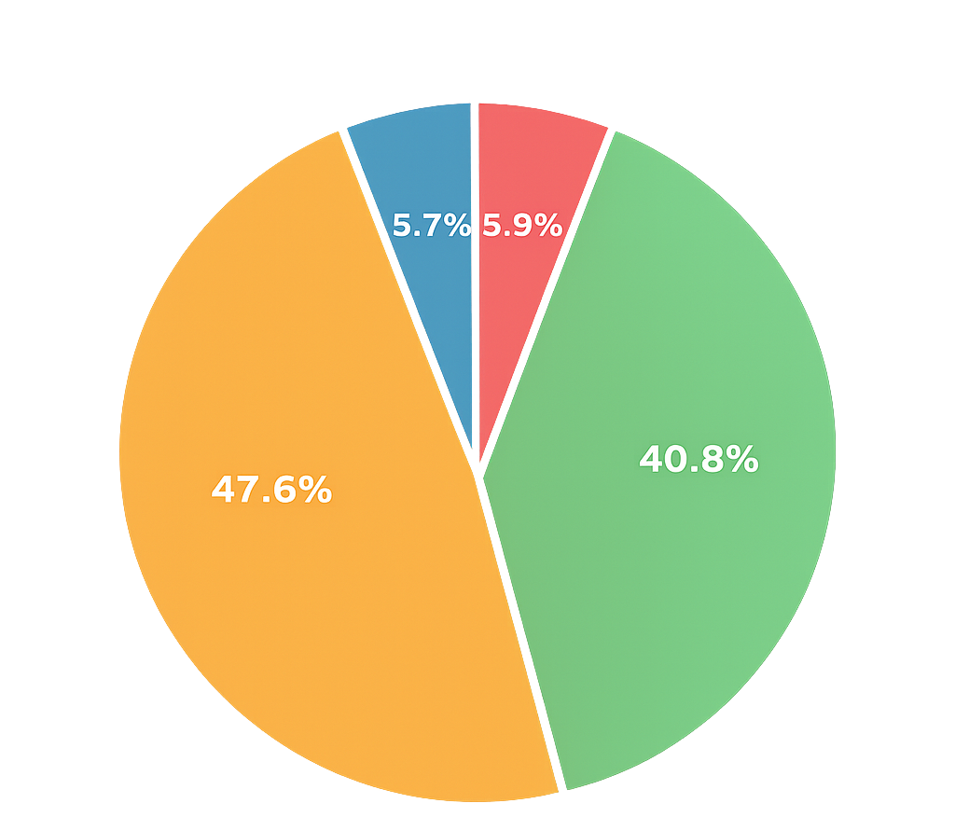
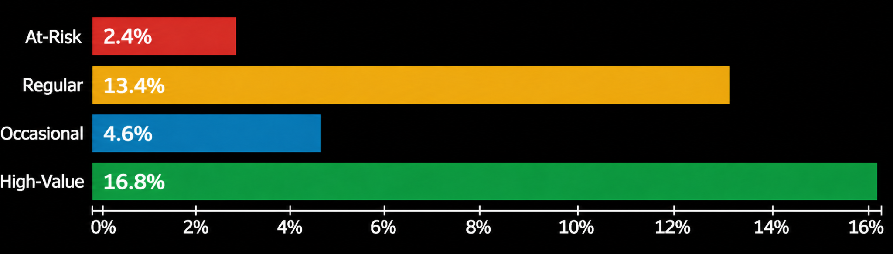
CUSTOMER SEGMENTATION — INSIGHTS
Revenue Concentration & Spending by Category
Revenue Contribution by Segment
Offer Acceptance Rate by Segment (%)
Key Segmentation Findings
Revenue is highly concentrated in the High Value and Regular segments, accounting for 90% of total revenue.
High Value and Regular customers show stronger campaign response rates, higher income, and greater total spend.
High Value
Regular
Occasional
At Risk

Slide 10
CHURN PREDICTION — METHODOLOGY
Modeling Pipeline & Design Decisions
Churn Definition: Binary label — Inactivity > 80 days since last purchase (industry standard for retail) | Class balance checked before modeling
Data Preparation
Logistic Regression
Random Forest Classifier
Target: churn = 1 if Recency > 80 days
Features: Recency, Frequency, Total Spend, Income, Age, Tenure, Campaign Acceptances
One-hot encoding for categorical variables (Education, Marital Status)
Median imputation for missing values
StandardScaler normalization on numeric features
80/20 train-test split (random_state=42)
Pipeline: ColumnTransformer → LogisticRegression
Solver: liblinear (stable for smaller datasets)
Preprocessing: median imputation + StandardScaler
One-hot encoded features passed through as-is
random_state=42 for reproducibility
Provides probability scores for churn risk
Pipeline: same ColumnTransformer preprocessing
n_estimators=10 (ensemble of decision trees)
Captures non-linear relationships & feature interactions
Handles feature importance natively
More robust to multicollinearity than LR
Selected as final model based on performance

Slide 11
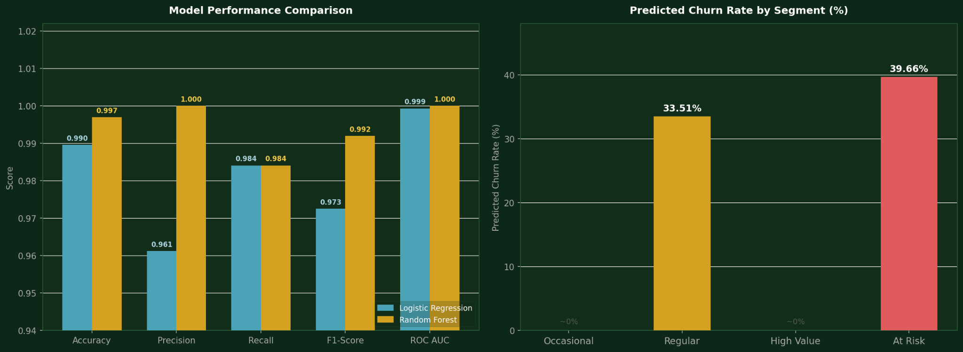
CHURN PREDICTION — RESULTS
Model Performance & Predicted Churn by Segment
Random Forest selected as final model: 99.7% accuracy, 100% precision, ROC AUC = 1.000 | Overall churn probability: 18.7% | At-Risk: 39.7% | Regular: 33.5%

Slide 12
Churn Analysis
What is Churn Prediction?
Identifying customers who are at risk of becoming inactive — defined as no purchase in 80+ days, consistent with retail industry benchmarks for churn detection.
Goal — Random Forest Classifier
Predict each customer's churn probability (0 to 1) using behavioral features like recency, purchase frequency, income, and channel usage — enabling proactive retention before customers lapse.
Key Finding
At-Risk segment carries 39% churn probability vs 0% for active segments. Regular customers at 33% — a segment that shops consistently but is showing signs of disengagement, making them a critical priority for retention efforts.
Churn Risk
Identify high- and low-value loyalty program members

Slide 13
PROBLEM STATEMENT
Customer Lifetime Value
What is CLV?
Customer Lifetime Value estimates how much revenue each customer generates per year: CLV = (Total Spend ÷ Days as Customer) × 365
Why Random Forest Regression?
CLV relationships are non-linear — Random Forest captures complex patterns better than Linear Regression and lets us extract feature importance to identify key business levers.
Key Finding
Purchase Rate (frequency ÷ active months) is the #1 driver of CLV at 81% — how consistently a customer buys matters more than income or any other variable. R² = 0.80
Predict CLV
Identify high- and low-value loyalty program members

Slide 14
CUSTOMER LIFETIME VALUE — METHODOLOGY
CLV Formula, Feature Engineering & Model Design
CLV Formula:
( Total Spend ÷ Days as Customer ) × 365
annualized
Target Variable
Features Used
Model: Random Forest Regression
CLV computed per customer from transaction history (2012–2014, ~1.5 years)
Annualized using total spend ÷ tenure in days × 365
Continuous regression target — not a classification problem
Distribution is right-skewed (median $257, mean $459)
PurchaseRate: frequency ÷ tenure days (#1 driver, 81% importance)
Income (9.6% feature importance)
Succ_web_purch — web purchase success rate (3%)
NumDealsPurchases, Age, NumWebVisitsMonth
Recency, Web_Share, NumCatalogPurchases
TotalChildren (household size context)
Chosen for ability to capture non-linear CLV relationships
Handles interactions between purchase rate, income, channels
R² = 0.80 — model explains 80% of CLV variance
Feature importance extracted to identify key business levers
Same preprocessing pipeline as churn model for consistency
Trained on 80% of data, evaluated on 20% holdout set

Slide 15
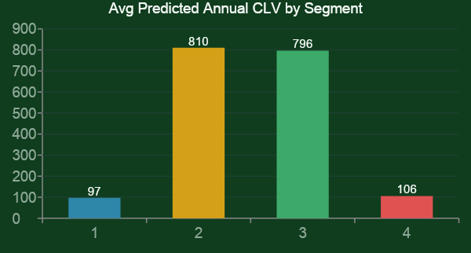
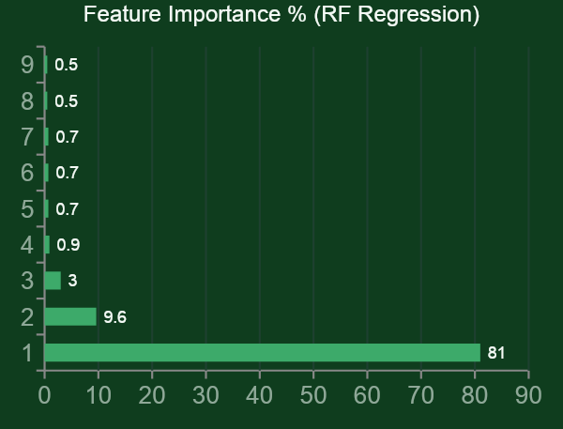
CUSTOMER LIFETIME VALUE — RESULTS
Predicted CLV by Segment & Feature Importance
$257
$459
$810
$796
$106
0.80
Median CLV (overall)
Mean CLV (overall)
Regular CLV/yr
High Value CLV/yr
At-Risk CLV/yr
Model R²

Slide 16
Dashboard and Recommendations
Provide a customer-level view with segment, churn risk, predicted CLV, and recommended action.
Overall, resources should focus first where customer value and revenue risk are highest.
The Regular segment is the top priority because it has high value but meaningful churn risk.
High-Value customers should be maintained and grown through targeted offers and increased purchase frequency.
Occasional customers should be nurtured selectively to move them into the Regular segment.
Recommendations
Deliver insights for strategic decision-making
Notes:
The Regular segment is the top priority because it has high value but meaningful churn risk.
High-Value customers should be maintained and grown through targeted offers and increased purchase frequency.
Occasional customers should be nurtured selectively to move them into the Regular segment.
Overall, resources should focus first where customer value and revenue risk are highest.

Slide 17
STRATEGIC RECOMMENDATIONS
Actionable Strategies by Customer Segment
Cluster 1 — Regular
TOP PRIORITY
Launch VIP loyalty tier with exclusive wine & premium category perks
Trigger personalized retention campaigns before 60-day recency mark
Monitor churn signals closely (33% churn risk and $810/yr CLV) – Win-back campaigns with discount triggers at 60-day inactivity + Proactive outreach
Cluster 2 — High value
MAINTAIN & GROW
Increase web conversion to increase purchase frequency
Cross-sell wine & meat product categories
Leverage high campaign acceptance rate (~17%) for upsell campaigns
Cluster 0 — Occasional
NURTURE SELECTIVELY
Track if occasional buyers migrate into Regular segment over time
Increase catalog sales following successful patterns of Regular segment
Focus on potential spender to promote cross-sell and upsell
Cluster 3 — At Risk
LOW-COST RETENTION
Deploy win-back campaigns with discount triggers at 60-day inactivity
Promote wine (highest offer redemption category) to re-engage
Set automated 60-day inactivity alerts for proactive outreach

Slide 18
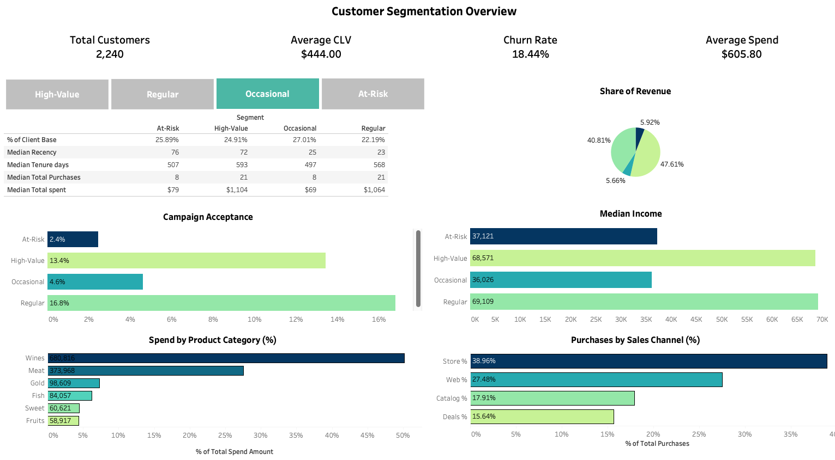
Dashboard Overview (Customer Segment Overview)
Julian Cerro · Waleed El-Jack · Marianne Murrle · Rachel Schultz · Tiana Quiroga · Spring 2026

Slide 19
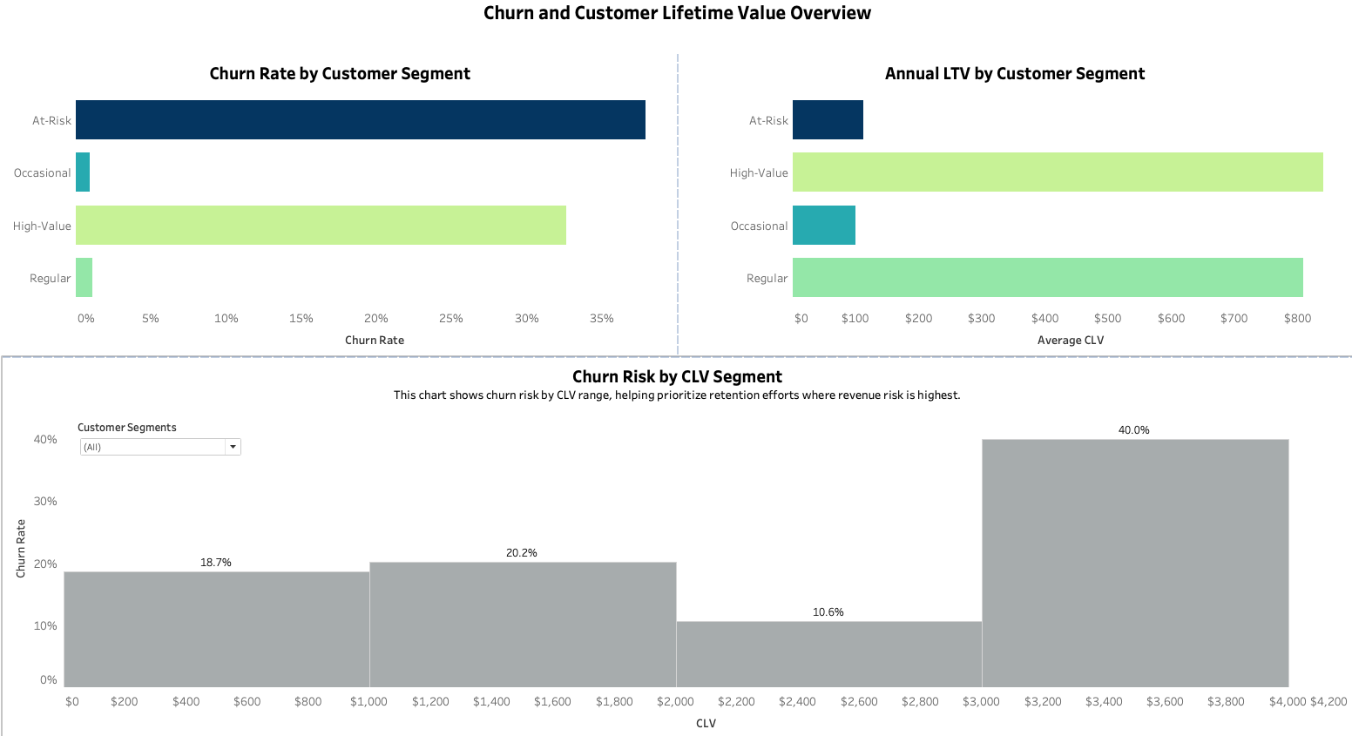
Dashboard Overview (Churn & CLV Overview)
Julian Cerro · Waleed El-Jack · Marianne Murrle · Rachel Schultz · Tiana Quiroga · Spring 2026

Slide 20
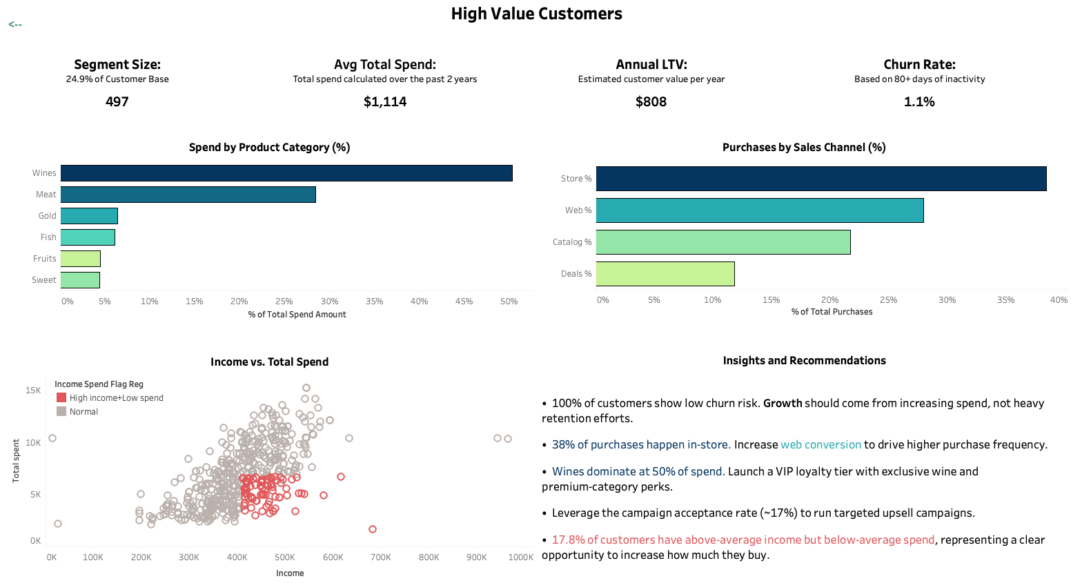
Dashboard Overview (Segment Deep Dive)
Julian Cerro · Waleed El-Jack · Marianne Murrle · Rachel Schultz · Tiana Quiroga · Spring 2026

